Slide 1

HD Assignment
Project
Thanh Thuy An Tran - ID 14218768
Unit: 32606 Database

Slide 2

Netflix DATABASE MODEL EXPLAIN
The database was designed based on Netflix website, which provides users with information about available show, description, genre, year published, maturity rate and list of artists participated in the show.
This model was further expanded to record information of Netflix users in terms of demography and action on site such as streamed shows, date watch and watching device to analyse users’ behaviour in order to improve site interaction and show content.

Slide 3
Netflix Entity Relationship Diagram
Netflix_CUSTOMER
CustomerID
CusName
Age
Location
Email
CUSTOMER _Watch
CustomerID
ShowDe_ID
DateWatch
Device
Are recorded
Watch
Artist
ArtistID
ArtName
Birth
Death
Country
Gender
Show_detail
ShowID
ShowDe_ID
Season
Episode
Length
Description
Year_published
Genre
Netflix_Role
ArtistID
ShowID
Role
Netflix _Show
ShowID
ShowName
ShowType
Plays
In
Has
Has
Netflix _Rating
ShowID
IDMB_rate
Maturity_rate

Slide 4

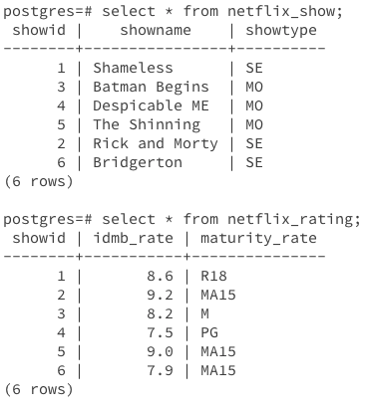
One-to-many Relationship
One-to-many relationship ERD between netflix_show and netflix_rating (one show can have many ratings) as shown in the ERD and realisation in tables:
Netflix _Show
ShowID
ShowName
ShowType
Netflix _Rating
ShowID
IDMB_rate
Maturity_rate

Slide 5
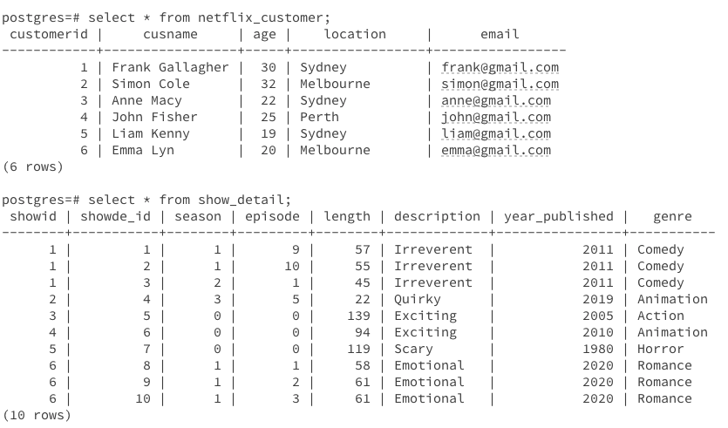
Many-to-many Relationship
Many-to-many relationship ERD between netflix_customer and show_detail (one customer can stream many shows, and one show can be watched by many customers) as shown in the ERD and realisation in tables:
Netflix_CUSTOMER
CustomerID
CusName
Age
Location
Email
CUSTOMER _Watch
CustomerID
ShowDe_ID
DateWatch
Device
Show_detail
ShowID
ShowDe_ID
Season
Episode
Length
Description
Year_published
Genre

Slide 6

SQL QUERIES
Simple query of a single table: List the number of movies and series available on Netflix
postgres=# select showtype, count(showid) as quantity from netflix_show group by showtype;
showtype | quantity
—————+-------
SE | 3
MO | 3
(2 rows)

Slide 7
SQL QUERIES
Natural join query: List the name of show that have IDMB rating higher than 8.0
postgres=# select showname, idmb_rate from netflix_show natural join netflix_rating where idmb_rate > 8.0;
showname | idmb_rate
----------------+-----------
Shameless | 8.6
Batman Begins | 8.2
The Shinning | 9.0
Rick and Morty | 9.2
(4 rows)

Slide 8
SQL QUERIES
Cross query: List the name of show that have IDMB rating higher than 8.0
postgres=# select showname, idmb_rate from netflix_show, netflix_rating where netflix_show.showid = netflix_rating.showid and idmb_rate > 8.0;
showname | idmb_rate
----------------+-----------
Shameless | 8.6
Batman Begins | 8.2
The Shinning | 9.0
Rick and Morty | 9.2
(4 rows)

Slide 9
SQL QUERIES
Group by and Having query: List the name of customer that streamed Netflix more than one time
postgres=# select cusname, count(showde_id) as frequency from netflix_customer natural join customer_watch group by cusname having count(showde_id) > 1 order by frequency;
cusname | frequency
-----------------+-----------
Simon Cole | 2
John Fisher | 2
Liam Kenny | 3
Frank Gallagher | 3
(4 rows)

Slide 10
SQL QUERIES
Sub-query query: List the name, description, genre and length of the longest movie on Netflix
postgres=# select showname, description, genre, length from netflix_show natural join show_detail where showtype = 'MO' and length = (select max(length) from show_detail);
showname | description | genre | length
---------------+-------------+--------+--------
Batman Begins | Exciting | Action | 139
(1 row)

Slide 11
Cross join query which cannot be done by natural join: List the all name of Netflix shows, streaming devices and its genres that watched by Netflix customers
postgres=# select a.cusname, b.showname, c.genre, d.device from netflix_customer a, netflix_show b, show_detail c, customer_watch d where a.customerid = d.customerid and d.showde_id = c.showde_id and b.showid = c.showid group by cusname, showname, genre, device;
cusname | showname | genre | device
-----------------+----------------+-----------+--------
John Fisher | The Shinning | Horror | MP
John Fisher | Despicable ME | Animation | LA
Frank Gallagher | Shameless | Comedy | LA
Liam Kenny | Bridgerton | Romance | MP
Simon Cole | Batman Begins | Action | TA
Frank Gallagher | Shameless | Comedy | MP
Anne Macy | The Shinning | Horror | TV
Simon Cole | Rick and Morty | Animation | MP
Liam Kenny | Bridgerton | Romance | TV
(9 rows)

Slide 12
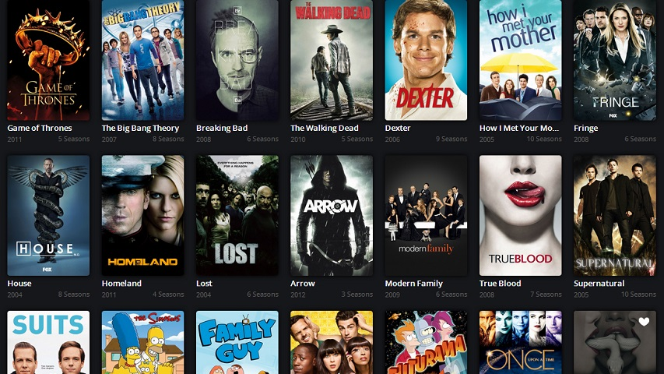
Sql check statement
A CHECK constraint specifies that the value in a certain column must satisfy certain condition:
Example of CHECK statements in my SQL database:
CREATE TABLE netflix_show
(
showid integer,
showname TEXT,
showtype char(2),
CONSTRAINT netflix_showPK PRIMARY KEY (showid),
CONSTRAINT di_table_netflix_show_showtype CHECK (showtype IN (
'MO', -- movie
'SE' -- series
))
);

Slide 13

CREATE TABLE artist
(
artistid integer,
artname TEXT,
birth integer,
death integer,
country TEXT,
gender char(1),
CONSTRAINT artistPK PRIMARY KEY (artistid),
CONSTRAINT di_table_artist_birth CHECK
((birth >= 1900) AND (birth <= 2010)),
CONSTRAINT di_table_artist_death CHECK
((death IS NULL) OR ((death > birth) AND (death <= 2021))),
CONSTRAINT di_table_artist_gender CHECK (gender IN (
'M', -- Male
'F')) -- Female
);

Slide 14

Sql action statement
CREATE TABLE show_detail
(
showid integer NOT NULL,
showde_id integer NOT NULL,
season integer NOT NULL,
episode integer NOT NULL,
length integer NOT NULL,
description TEXT,
year_published integer NOT NULL,
genre TEXT NOT NULL,
CONSTRAINT show_detailPK PRIMARY KEY (showde_id),
CONSTRAINT show_detailFK FOREIGN KEY (showid)
REFERENCES netflix_show ON DELETE CASCADE,
CONSTRAINT di_table_show_detail_year_published CHECK
((year_published >= 1950) AND (year_published <= 2021))
);

Slide 15

CREATE TABLE customer_watch
(
customerid integer NOT NULL,
showde_id integer NOT NULL,
datewatch DATE,
device char(2),
CONSTRAINT customer_watchPK PRIMARY KEY (customerid, showde_id),
CONSTRAINT customer_watchFK_id FOREIGN KEY (customerid) REFERENCES netflix_customer (customerid) ON UPDATE CASCADE,
CONSTRAINT customer_watchFK_show FOREIGN KEY (showde_id) REFERENCES show_detail (showde_id) ON DELETE RESTRICT,
CONSTRAINT di_table_customer_watch_device CHECK (device IN (
'MP', -- mobile phone
'TA', -- tablet
'LA', -- laptop
'TV' -- television
))
);

Slide 16
View in SQL
CREATE VIEW NetflixSeries AS
SELECT showname as name, showtype as classification, count(season) as season, description, year_published as year, genre
from netflix_show natural join show_detail
where showtype = 'SE'
group by showname, showtype, description, year_published, genre;
postgres=# select * from NetflixSeries;
name | classification | season | description | year | genre
----------------+----------------+--------+-------------+------+-----------
Bridgerton | SE | 3 | Emotional | 2020 | Romance
Rick and Morty | SE | 1 | Quirky | 2019 | Animation
Shameless | SE | 3 | Irreverent | 2011 | Comedy
(3 rows)

Slide 17

View in SQL
CREATE VIEW NetflixArtist AS SELECT a.artname, a.birth, a.country, a.gender, b.role, c.showname as artwork
from netflix_show c, netflix_role b, artist a
where a.artistid = b.artistid and b.showid = c.showid;
postgres=# select * from NetflixArtist;
artname | birth | country | gender | role | artwork
-----------------+-------+---------+--------+----------+----------------
William H. Macy | 1950 | USA | M | Cast | Shameless
John Wells | 1963 | USA | M | Creator | Shameless
Dan Harmon | 1964 | USA | M | Creator | Rick and Morty
Katie Holmes | 1977 | USA | F | Cast | Batman Begins
Pierre Coffin | 1971 | France | M | Director | Despicable ME
Shelley Duvall | 1952 | USA | F | Cast | The Shinning
Diane Johnson | 1938 | USA | F | Writer | The Shinning
Julie Andrews | 1939 | England | F | Cast | Shameless
(8 rows)

Slide 18
Thank you

